Slide 1
Quantum Computing
3.10.2018
Hassan Naseri, TIM

Slide 2
CONTECTS
Introduction to Quantum Computing
Problem Setup – Unstructured Search
QISKIT Hello World!
Grover’s Algorithm – Overall Procedure
Quantum Information Theory, Gate Model
Grover’s Algorithm - Details
Conclusions
Overall:
Very nice overview
+ dive into the details!

Slide 3
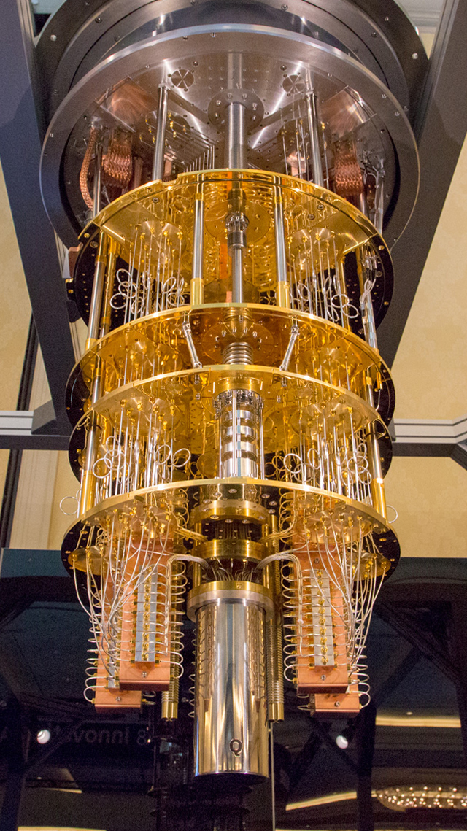
What is Quantum Computing?
Quantum computer is not a faster computer!
In a quantum computer:
The information is stored in a quantum system.
The computation is governed by quantum-mechanical phenomena.
It is fundamentally different from digital computers and .

Slide 4
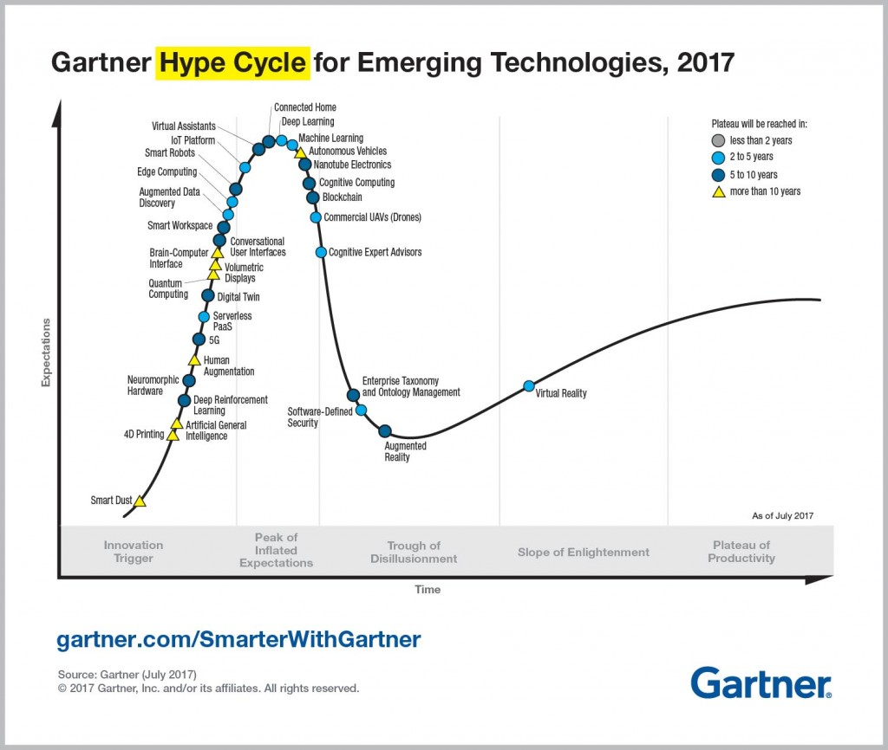
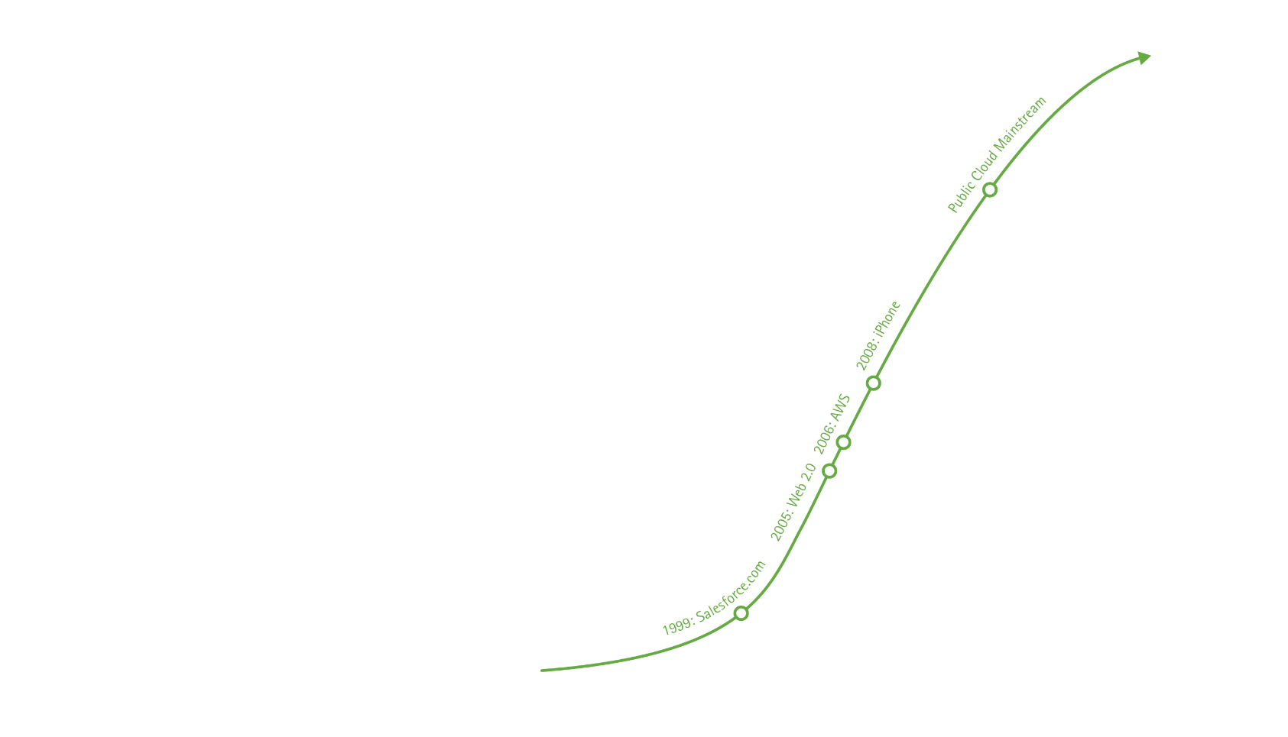
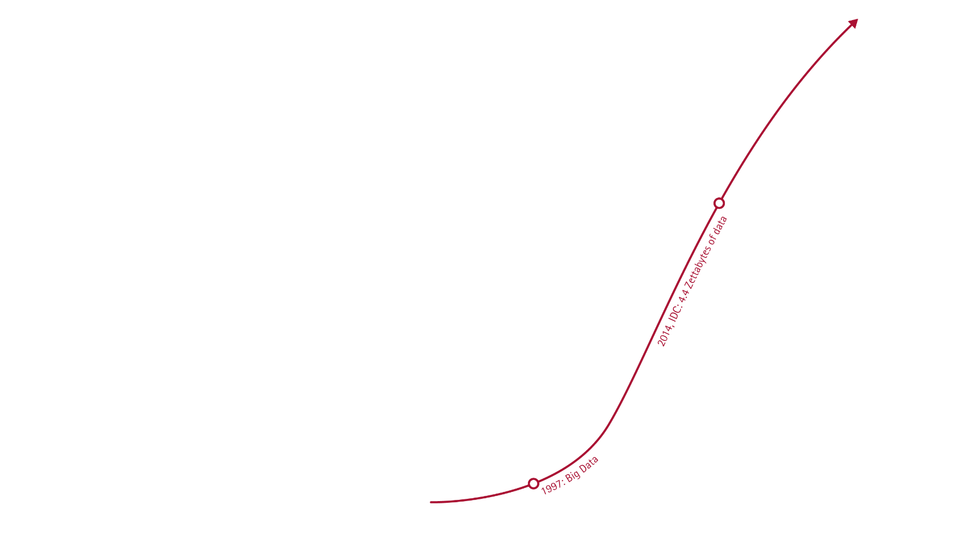

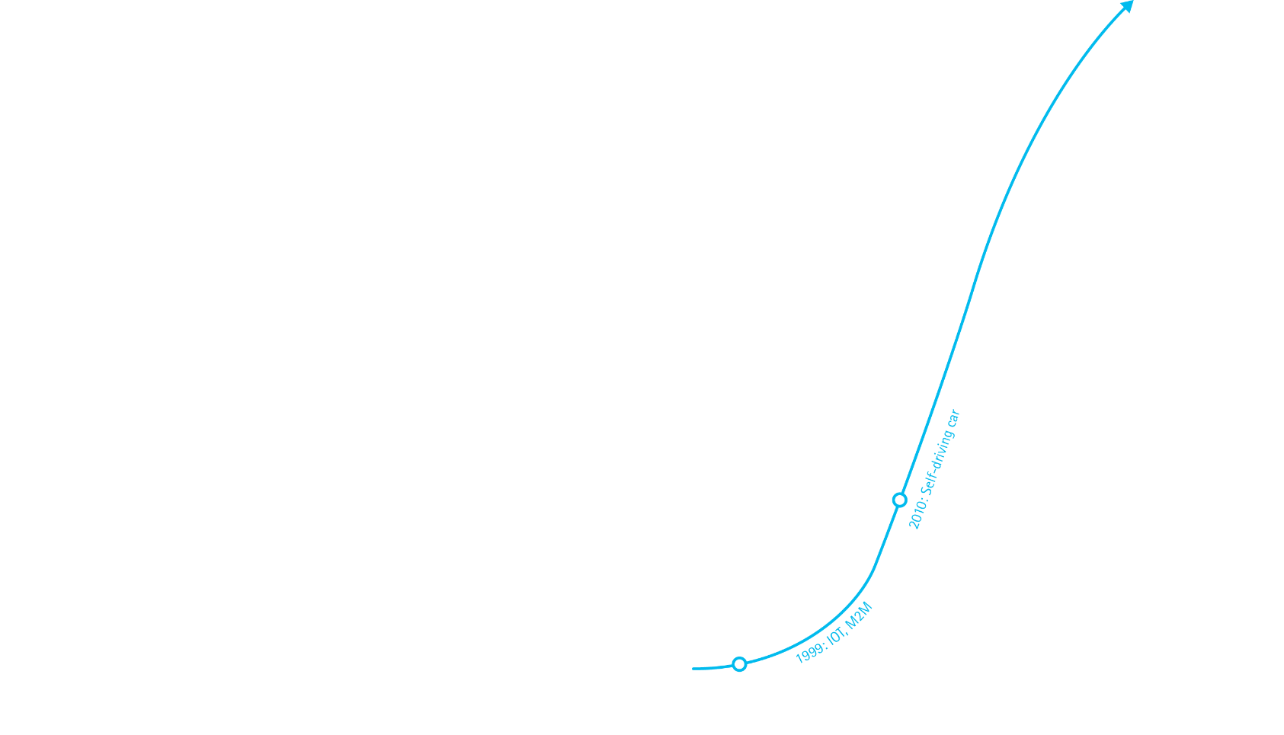
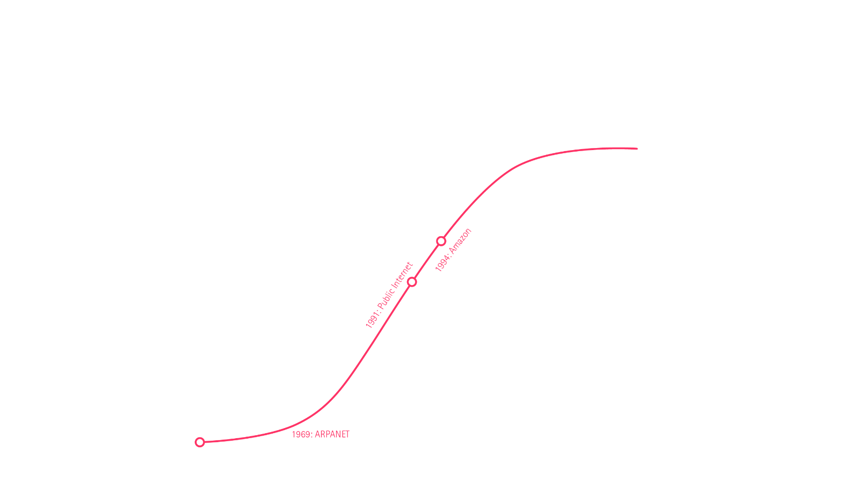
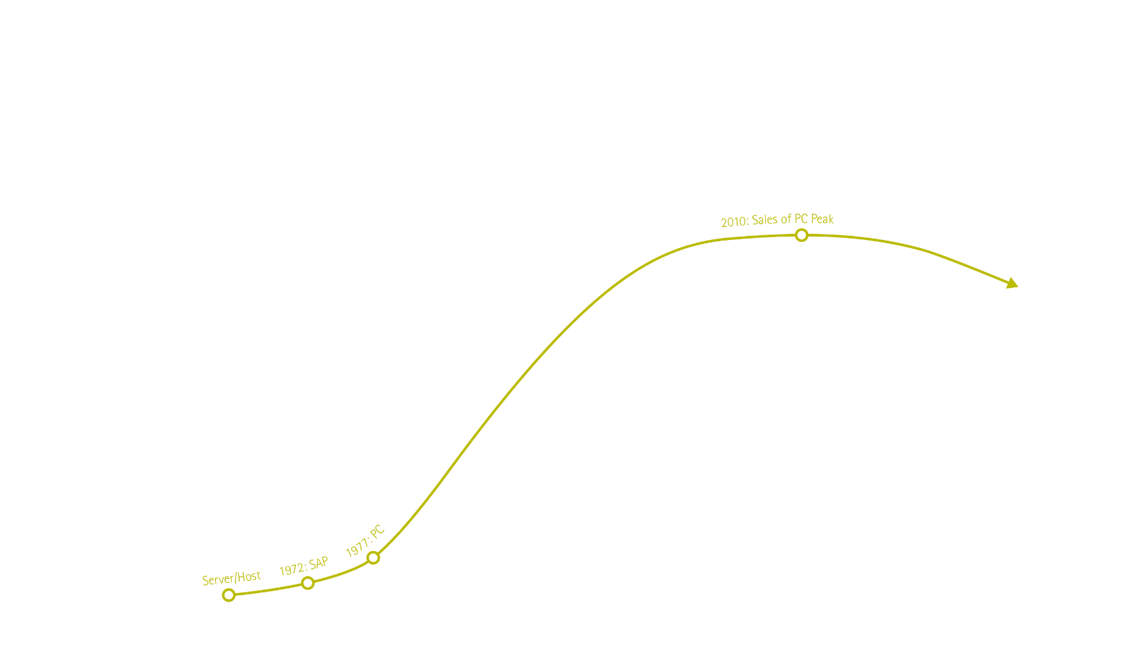
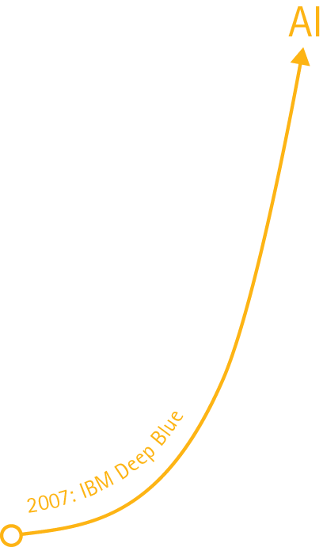
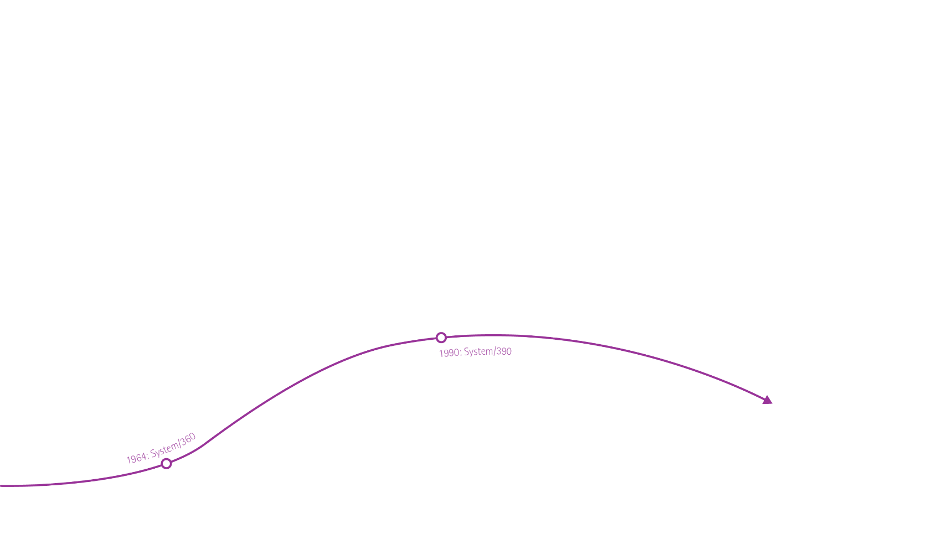



QUANTUM COMPUTING Timeline
[1959] | Richard Feynman: “There's Plenty of Room at the Bottom”
[1973] | Charles H. Bennett (IBM): introduce reversible logic
[1994] | Peter Shor (Bell Labs): an important algorithm to cryptography
[2000] | Alamos National Laboratory: first working 7-qubit NMR
[2007] | D-Wave : 8-qubit quantum annealing computer
[2016] | IBM: public launch of IBM Q Experience and a 5 qubit universal quantum computer.
[2017 – 2018] | IBM: unveils a 50-qubit quantum computer. Microsoft: releases Quantum SDK and a 40-qubit simulator. Google: announces a 72-qubit quantum chip Intel: announces a 49-qubit superconducting test chip.
Exponential growth of superconducting quantum computing technology
Quantum

Slide 5
Future is quantum!
The promise of outperforming every classical computer to an extraordinary degree for certain tasks.
Change the world by solving problems that are intractable with today's technology.
Very likely to disrupt every industry in near future.
Market Situation:
Public funds (2018): US ($1.3B), EU (€1.1B), UK (£240M), China (>$10B), etc.
Private sector: IBM, Google, Intel, Microsoft, and many startups.
Big consultants, banks and industry: Deloitte, KPMG, JPMorgan Chase, DAIMLER, Barclays, Accenture, etc.

Slide 6






TWO MAIN TECHNOLOGIES
Adiabatic Quantum Computer
Also known as quantum annealing
Approximate answers to optimization problems.
Cannot run standard quantum algorithms.
Much larger machines available.
Universal Quantum Computer
Can solve any classical or quantum algorithm (E.g. IBM, Google).
Quantum Gate Model / Quantum Circuit.
Provides quantum speedup for certain algorithms developed.
Still very limited hardware.

Slide 7

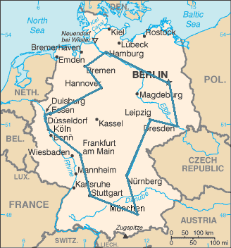
IT IS ALL ABOUT COMPLEXITY
Computationally complex problems require more space and time.
The difference in complexity can make a problem intractable.
There are many intractable problems (usually approximated!)
Example:
A UPS truck has to deliver 400 packets in Helsinki. The TSP has complexity O(2⁴⁰⁰)
A quantum computer is not generally faster or parallel.
Quantum speedup:
There are problems which are classically hard and quantumly easy!
Quantum speedup requires the existence of a corresponding quantum algorithm.
An optimal traveling salesperson tour through Germany’s 15 largest cities. It is the shortest among 43,589,145,600 possible tours visiting each city once.

Slide 8
CONTECTS
Introduction to Quantum Computing
Introduction to Quantum Information
Problem Setup – Unstructured Search
QISKIT Hello World!
Grover’s Algorithm – Overall Procedure
Grover’s Algorithm - Details
Conclusions

Slide 9
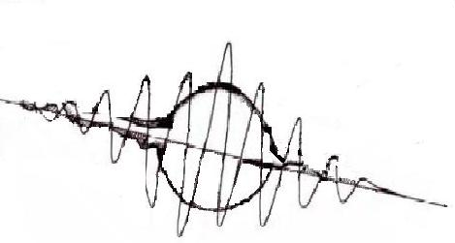
The future of computing is not digital!
Quantum computing is not electronic.
It is not based on our current technology of electronics, semiconductor, …
There are few technologies under development.
The winning technology is not clear yet, but it should be one.
Quantum computing is not digital.
It can be considered a type of analogue computation, i.e., not discretized.
It is probabilistic.
It is quite noisy nowadays.

Slide 10
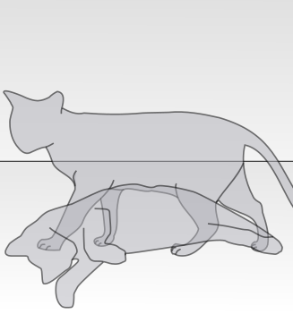
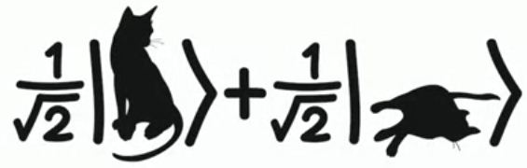
Do NOT WORRY about Quantum Physics
Superposition, Collapse, Entanglement, Teleportation
The physics can be difficult and subject to different interpretations.
Mathematics are simple and do not require interpretation.
Two important laws:
Quantum operations are reversible.
Measurement is irreversible

Slide 11
SOME TECHNICAL DETAILS! What is a QUBIT?
A superposition of TWO QUANTUM STATES.

Slide 12
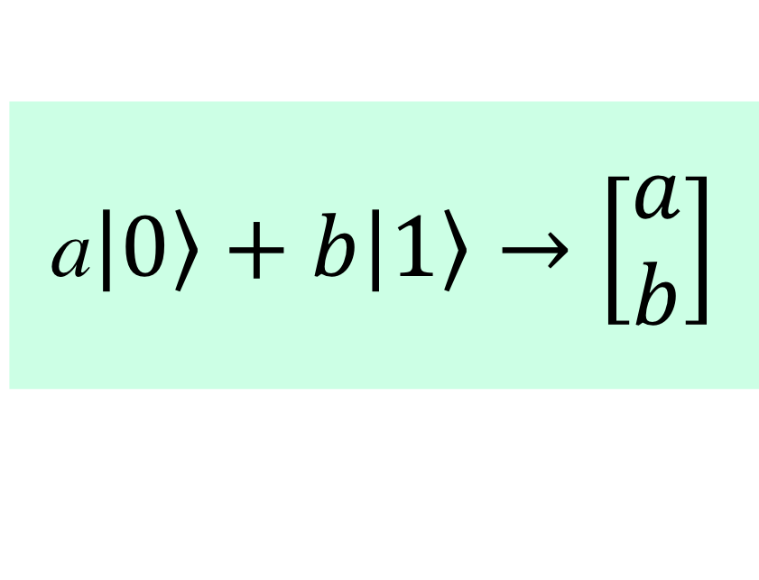
MATHEMATICAL REPRESENTATION
Left
A Qubit is a Linear combination of two or more states.
Right
a$\left|\left.0\right\rangle +b\right|\left.1\right\rangle →\left[\begin{matrix}a \\ b\end{matrix}\right]$

Slide 13
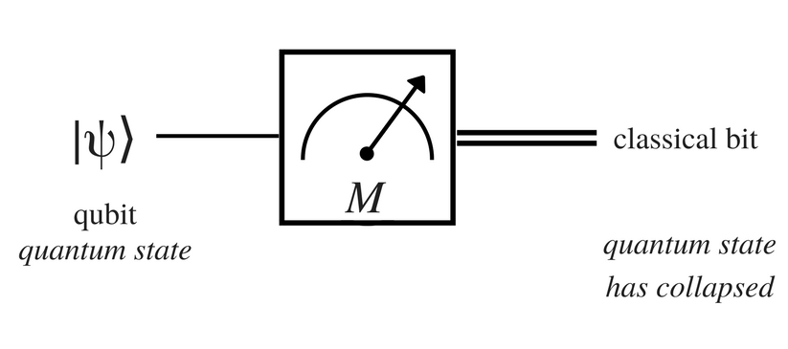
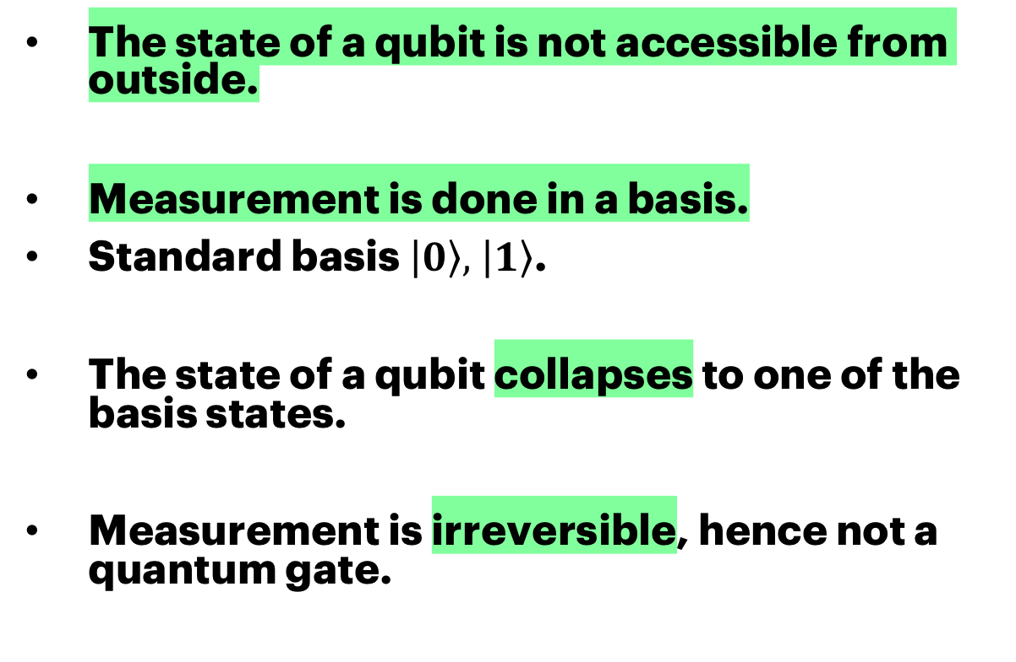
Measurement
The state of a qubit is not accessible from outside.
Measurement is done in a basis.
Standard basis $\left|\left.0\right\rangle , \right|\left.1\right\rangle$.
The state of a qubit collapses to one of the basis states.
Measurement is irreversible, hence not a quantum gate.

Slide 14
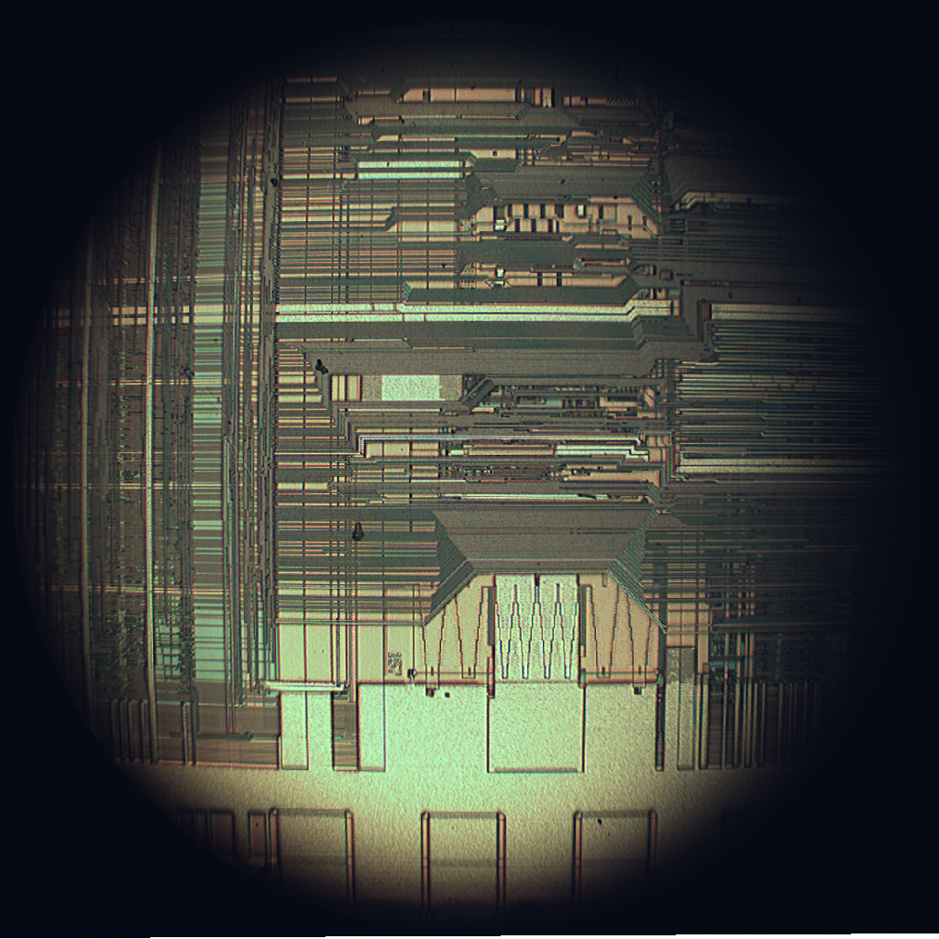

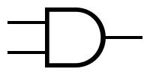
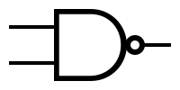

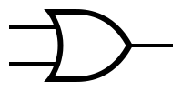


Classical Computing: Modern Digital Computers
Electronic: using electrons to process information
Digital: information units are bits (0/1)
Silicon-based transistor logic (MOSFET)
Basic gates: AND, OR, NAND, …
Universal gates: NAND, NOR
Most system use a single universal
Full adder made of NAND gates

Slide 15
Quantum Gate Model UNIVERSAL QUANTUM COMPUTER
A universal quantum computer made from simple gates.
Most common gates: 1-qubit and 2-qubit gates
Quantum logic gates are reversible.
Quantum logic gates are represented by unitary matrices.
Due to this inherent randomness (and also noise), the process is repeated and measured many times to find the probabilities of each state.

Slide 16
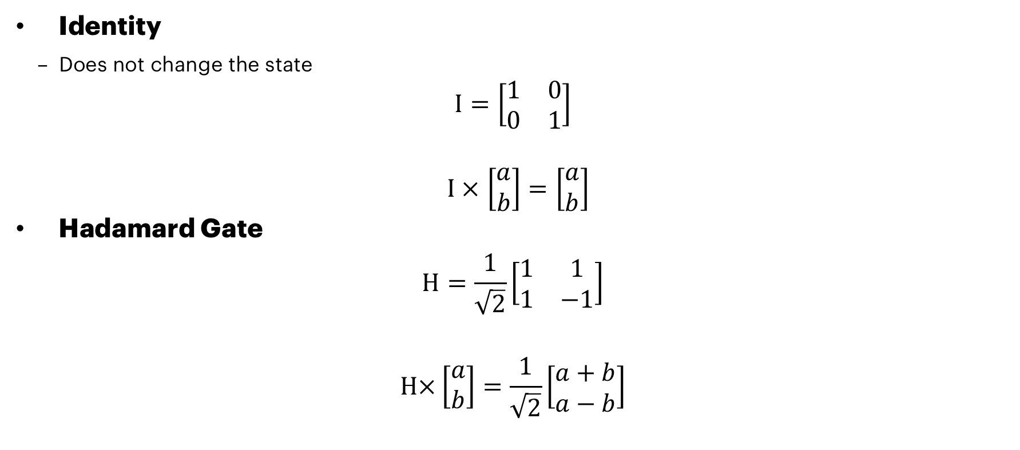
IDENTITY and Hadamard GAteS
Identity
Does not change the state
$$I=\left[\begin{matrix}1 & 0 \\ 0 & 1\end{matrix}\right]$$
$I ×$ $\left[\begin{matrix}a \\ b\end{matrix}\right]=\left[\begin{matrix}a \\ b\end{matrix}\right]$
Hadamard Gate
$$H=\frac{1}{\sqrt{2}}\left[\begin{matrix}1 & 1 \\ 1 & −1\end{matrix}\right]$$
$$H×\left[\begin{matrix}a \\ b\end{matrix}\right]=\frac{1}{\sqrt{2}}\left[\begin{matrix}a+b \\ a−b\end{matrix}\right]$$
I
H

Slide 17
CONTECTS
Introduction to Quantum Computing
Introduction to Quantum Information
QUANTUM Hello World!
Problem Setup – Unstructured Search
Grover’s Algorithm – Overall Procedure
Grover’s Algorithm - Details
Conclusions

Slide 18
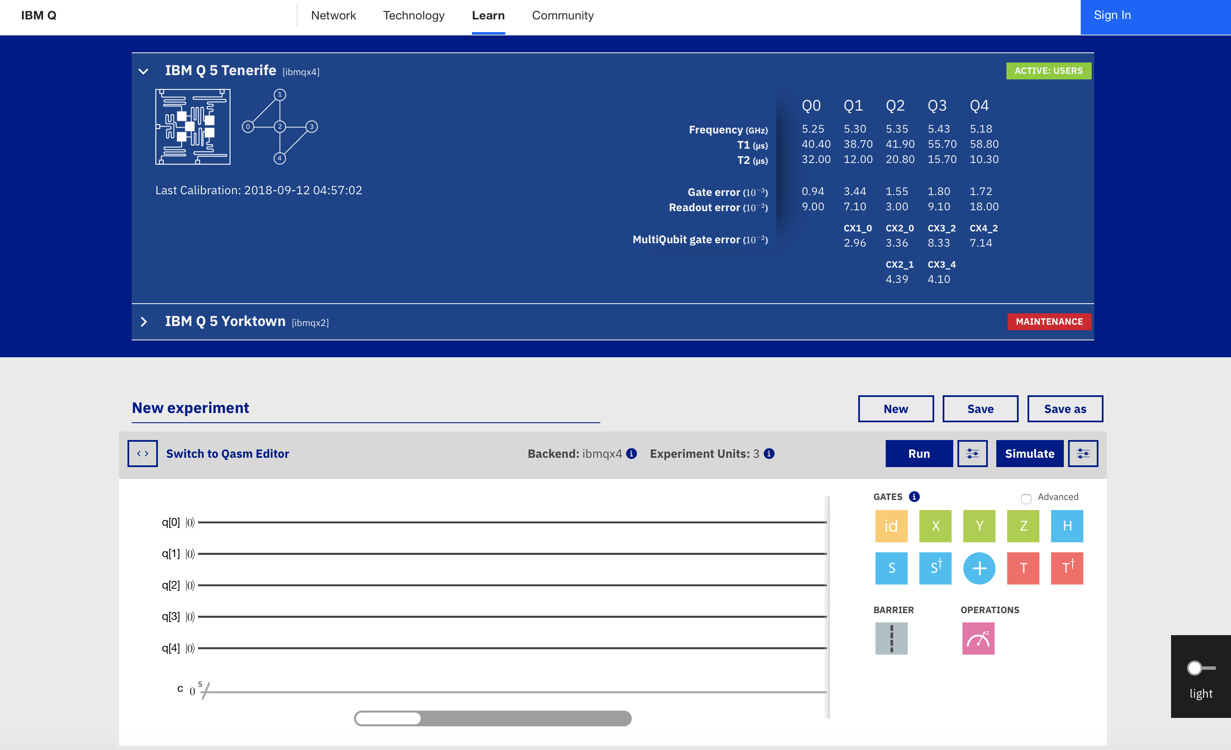
Different programming options for IBM Q system
Graphical interface (IBM Q – Composer)
OpenQASM
Open Quantum Assembly Language
Qiskit (Python SDK)
Qiskit-Aqua (Python library)

Slide 19
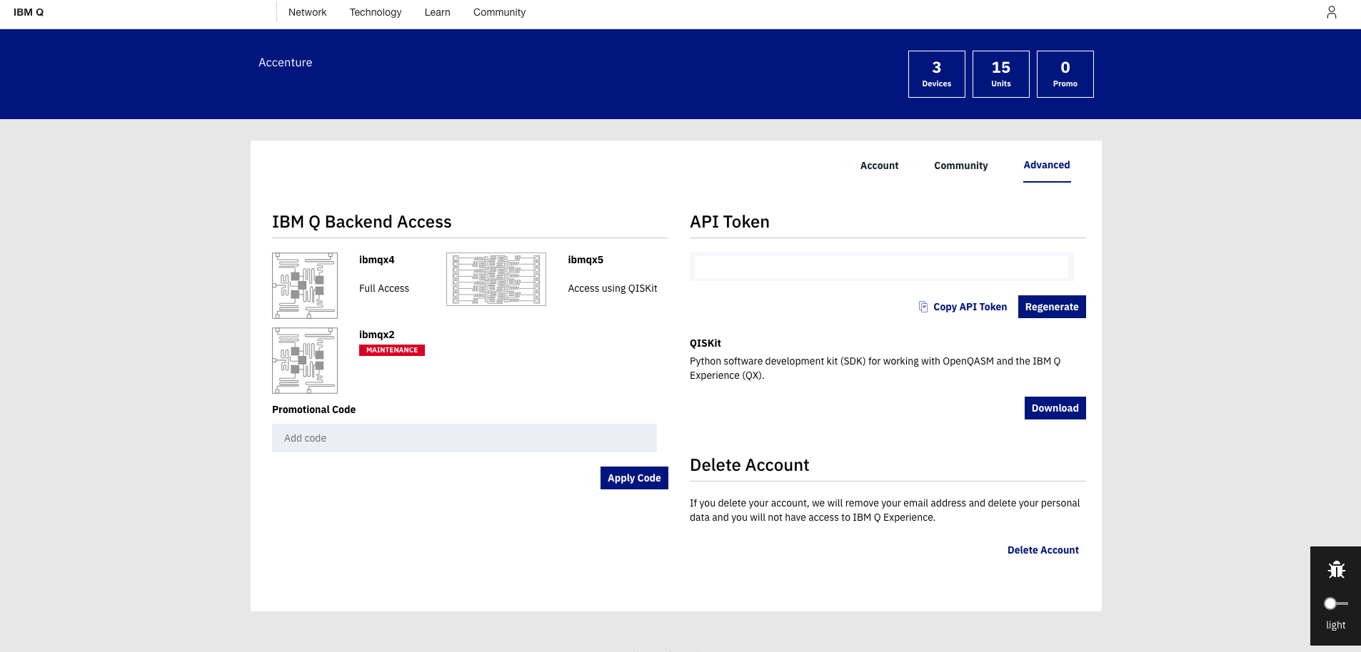
Create an IBM Q account and Get your token
Navigate to: https://quantumexperience.ng.bluemix.net/qx/editor
Click “sign in”
Choose your favorite identity provider and login
Navigate to: https://quantumexperience.ng.bluemix.net/qx/account/advanced
(Account → Advanced)
Copy your API token, you will need it for executing experiments from Qiskit
Your token

Slide 20
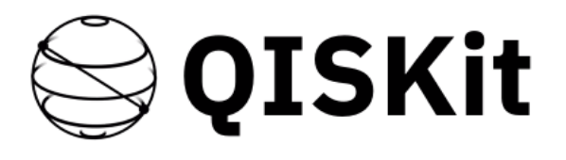
Quantum Programming – QISKIT
QISKIT (Quantum Information Science Kit) is an open-source quantum computing framework.
It is a Python SDK.
Backends: IBM Q computers, local and remote simulators
The starting point for writing code is the QuantumCircuit.
Tutorial: https://qiskit.org/documentation/quickstart.html
SDK reference: https://qiskit.org/documentation/_autodoc/qiskit.html

Slide 21
QISKIT SETUP JUPYTER NOTEBOOK
Navigate to
https://mybinder.org/v2/gh/HassanNaseri/quantum-computing-handson/master
Open file: hello_qiskit.ipynb
Registring your credentials
Needs API Token and the QX URL.
Needs to be done only once.
Import the Qiskit SDK
QX_TOKEN = "728624125ddfb3acc6485060d3c3bbd63e8c1373e65b3e8d1f29fd91417c75f7efa60cccd73f17669da651e24669c8a2865e7c1fcefc01a3879dd5c735003244"
QX_URL = "https://quantumexperience.ng.bluemix.net/api"
from qiskit import register
register(QX_TOKEN, QX_URL)
from qiskit import QuantumCircuit, ClassicalRegister, QuantumRegister
from qiskit import available_backends, execute

Slide 22
QISKIT CODE EXAMPLE – HELLO WORLD
from qiskit import QuantumCircuit, ClassicalRegister, QuantumRegister
from qiskit import available_backends, execute
Hello World!
Create registers
Create circuit
Add Hadamard gate
Add measurement
Plot circuit
Execute
Get results and print
Source code here:
https://mybinder.org/v2/gh/HassanNaseri/quantum-computing-handson/master
print("Available backends: ", available_backends())
# Create a Quantum Register with 1 qubit. The initial state is |0>
q = QuantumRegister(1)
# Create a Classical Register with 1 bit.
c = ClassicalRegister(1)
# Create a Quantum Circuit
qc = QuantumCircuit(q, c)
# Add Hadamard gate to the qubit, putting it in superposition state.
qc.h(q)
# Add a Measurement gate to see the state.
qc.measure(q, c)
plot_circuit(qc)
job_sim = execute(qc, "local_qasm_simulator")
sim_result = job_sim.result()
print("simulation: ", sim_result)
print(sim_result.get_counts(qc))

Slide 23
CONTECTS
Introduction to Quantum Computing
Introduction to Quantum Information
QUANTUM Hello World!
QUANTUM Algorithms
Problem Setup – Unstructured Search
Grover’s Algorithm – Overall Procedure
Grover’s Algorithm - Details
Conclusions

Slide 24
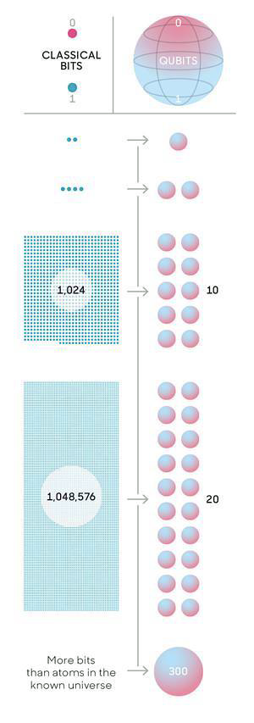
Quantum Computing Algorithms
The space of a quantum system grows exponentially.
Quantum speedup requires quantum algorithms.
It is difficult to design a new quantum algorithm.
Different categories of algorithms:
Exact algorithms
Approximate techniques
Hybrid algorithms
Quantum communication
Quantum algorithm provide exponential or quadratic speedup.

Slide 25
Quantum Algorithms – for universal Computers
Three categories of quantum algorithms:
Quantum Fourier transform (QFT) (exponential speedups)
Shor's algorithm: factorization of prime numbers
Quantum algorithm for linear systems of equation
Amplitude amplification (quadratic speedups)
Grover's algorithm: searches an unstructured database
Quantum walks
Graph optimization algorithms.
It is difficult to design a new Quantum algorithm!

Slide 26
Application Area : Cryptography
Cryptography Threat
RSA public key cryptosystem is based on complexity of solving a math problem.
Shor’s algorithm on a large quantum computer can break it in a short time.
Such a computer could be available in 10 years.
Many other cryptosystems are also at risk.
Responses
Improving our current security practices
Post-quantum cryptography
Quantum communications
How much time do we have?
How long would it take for a bank to plan and execute a security upgrade on legacy systems?
What will happen to the archive of digitally-signed documents in a legal department?
Do we have future-proof practices for data protection?

Slide 27
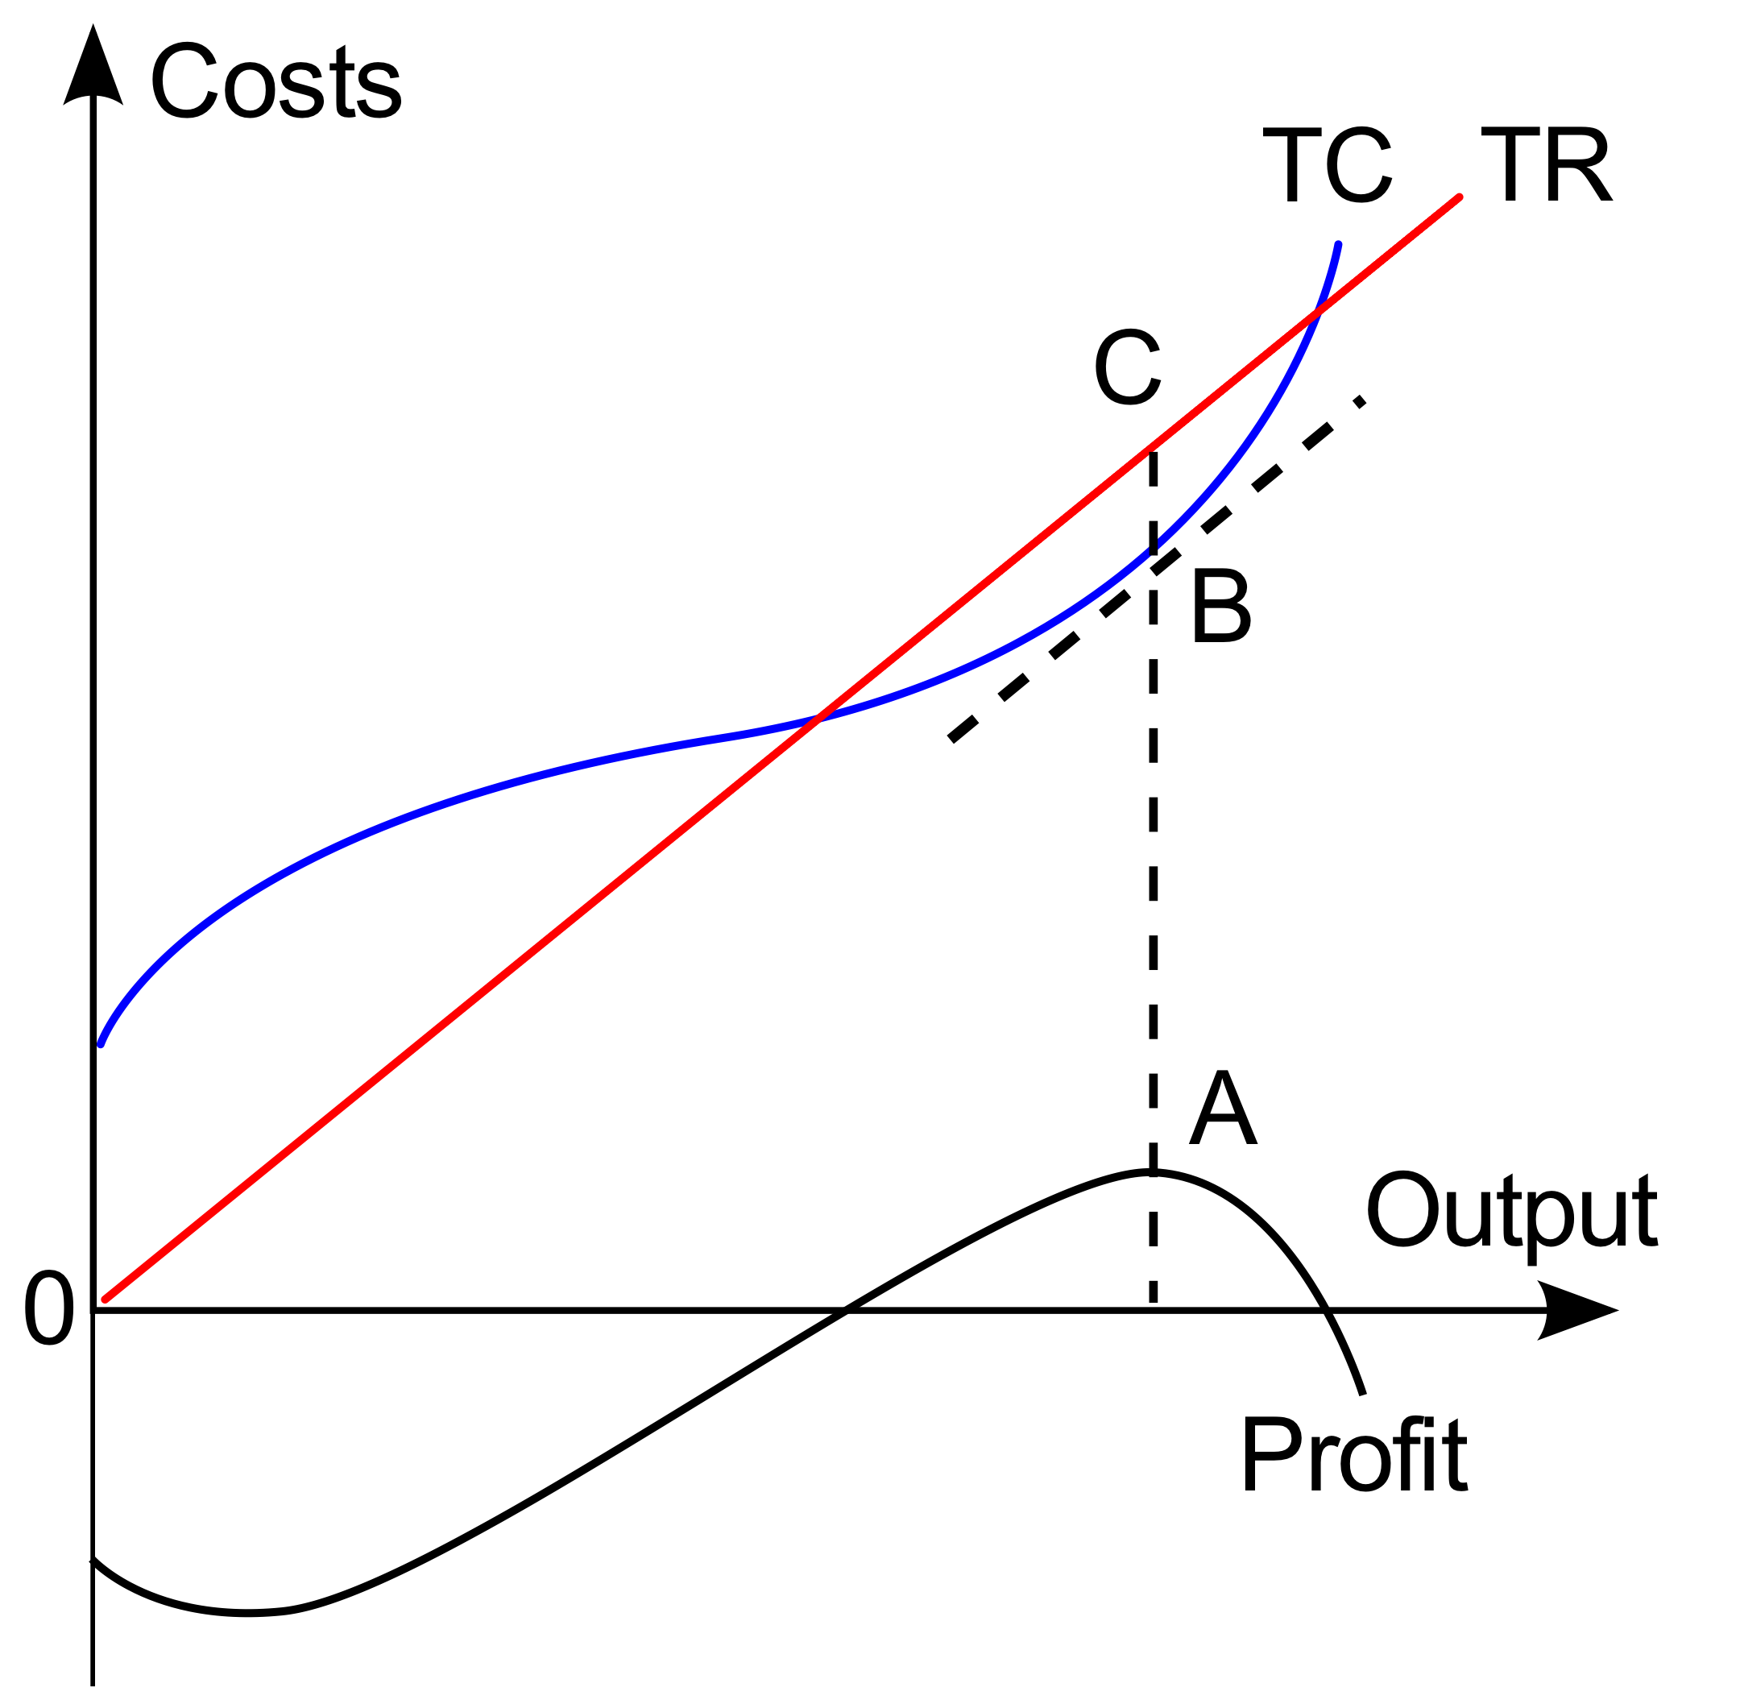
Application Area : Optimization and MACHINE LEARNING
Mathematical optimization deals with finding the best solution to a problem.
Examples: Portfolio optimization, Risk minimization
Optimization methods are the building blocks of machine learning and AI solutions.
Quantum computing has the promise of:
Solving problems which are classically infeasible .
Obtaining a substantial speedup in optimization.
Example techniques:
Quantum data fitting (regression)
Quantum semidefinite programming
Quantum combinatorial optimization
Quantum support vector machine

Slide 28
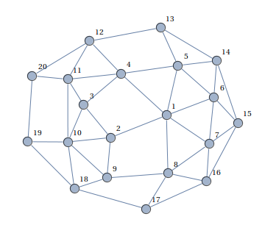
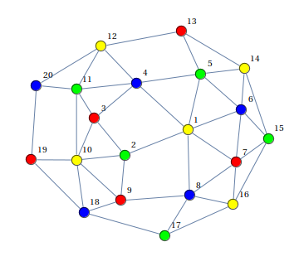
Example - Portfolio Optimization
Portfolio optimization can easily become an intractable combinatorial optimization problem.
Example: Find portfolios containing only uncorrelated assets to minimize risk.
We represent the problem as a graph, where:
Each asset corresponds to one node
Each positive correlation is one edge
Each node color corresponds to one portfolio
Graph coloring problem: assign a color to each node avoiding a similar color on connected nodes.
Technique: Quantum annealing on a D-Wave machine

Slide 29
Application Areas – Quantum key distribution
Alice
Classic Channel
Bob
In Cryptography a secret key is used to encrypt/decrypt messages.
Key distribution is a mechanism to share a key between two parties in a secure manner.
Quantum entanglement provides a mechanism to distribute keys – completely tamper proof.
Quantum Channel
Eve
Current Status
Currently available for point to point cases.
Experiment: Shanghai to Beijing via satellite.

Slide 30
CONTECTS
Introduction to Quantum Computing
Introduction to Quantum Information
Quantum Hello World!
Introduction to Quantum Algorithms
Quantum Gate Model and Quantum Circuit
Grover’s Algorithm – Overall Procedure
Grover’s Algorithm - Details
Conclusions

Slide 31
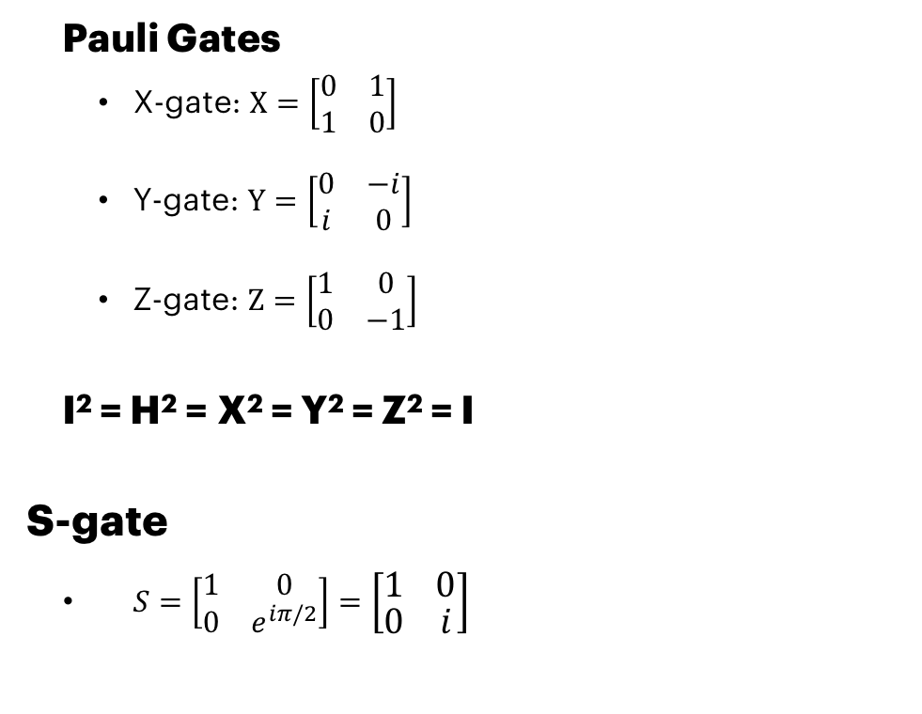
OnE Qbit Gates Cont. Pauli gates and S-Gate
Pauli Gates
X-gate: $X=\left[\begin{matrix}0 & 1 \\ 1 & 0\end{matrix}\right]$
Y-gate: $Y=\left[\begin{matrix}0 & −i \\ i & 0\end{matrix}\right]$
Z-gate: $Z=\left[\begin{matrix}1 & 0 \\ 0 & −1\end{matrix}\right]$
I² = H² = X² = Y² = Z² = I
S-gate
$S=\left[\begin{matrix}1 & 0 \\ 0 & e^{iπ/2}\end{matrix}\right]=\left[\begin{matrix}1 & 0 \\ 0 & i\end{matrix}\right]$
X
Y
Z
S
Z^{1/2}

Slide 32
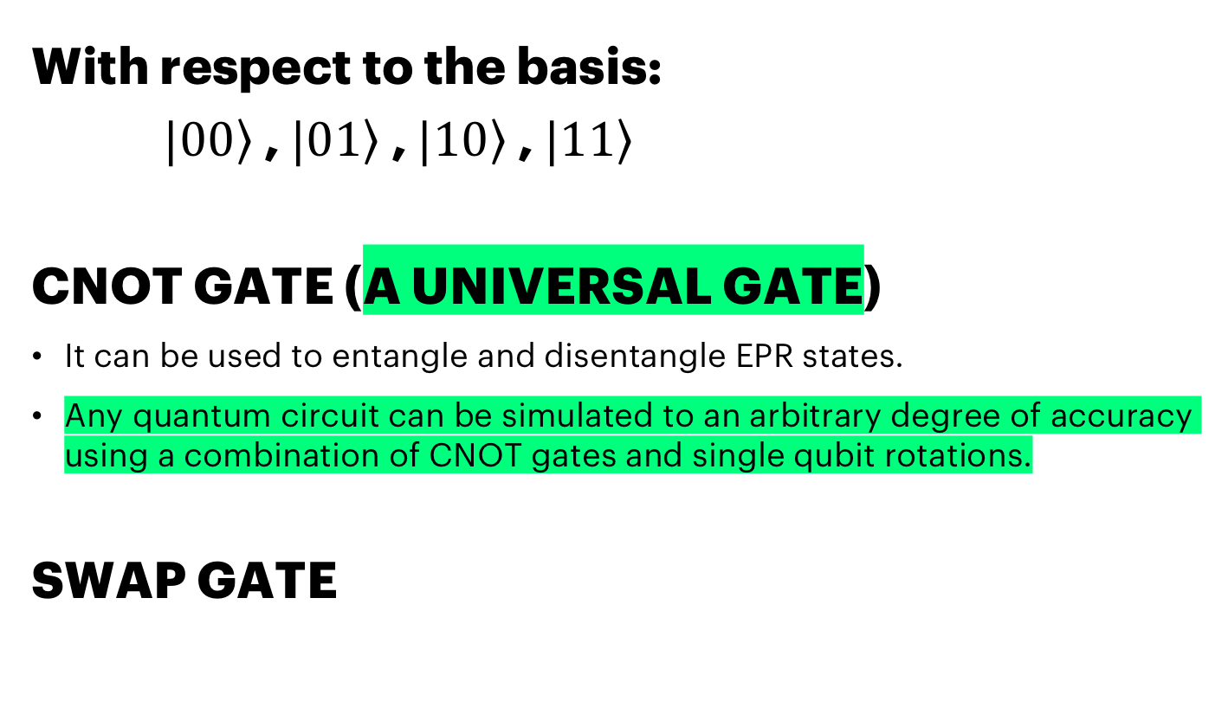
TWO-Qubit gates
With respect to the basis:
$|0\left.0\right\rangle$, $|0\left.1\right\rangle$, $|1\left.0\right\rangle$, $|1\left.1\right\rangle$
CNOT GATE (A UNIVERSAL GATE)
It can be used to entangle and disentangle EPR states.
Any quantum circuit can be simulated to an arbitrary degree of accuracy using a combination of CNOT gates and single qubit rotations.
SWAP GATE

Slide 33
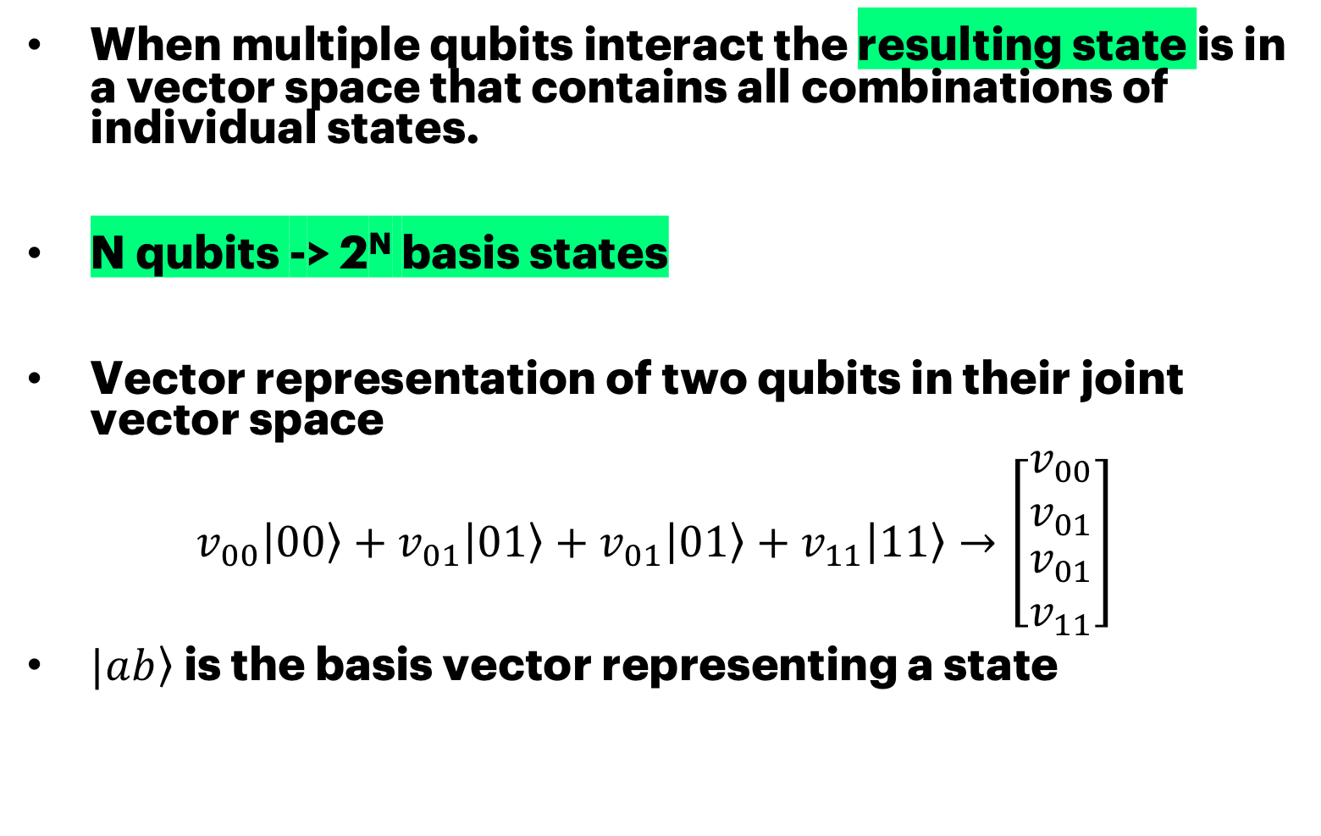
VECTOR SPACE AND ENTAGLEMENT
When multiple qubits interact the resulting state is in a vector space that contains all combinations of individual states.
N qubits -> 2^{N} basis states
Vector representation of two qubits in their joint vector space
$$v_{00}\left|\left.00\right\rangle +v_{01}\right|0\left.1\right\rangle +v_{01}\left|\left.01\right\rangle +v_{11}\right|1\left.1\right\rangle →\left[\begin{matrix}v_{00} \\ v_{01} \\ \begin{aligned}v_{01} \\ v_{11}\end{aligned}\end{matrix}\right]$$
$|a\left.b\right\rangle$is the basis vector representing a state

Slide 34
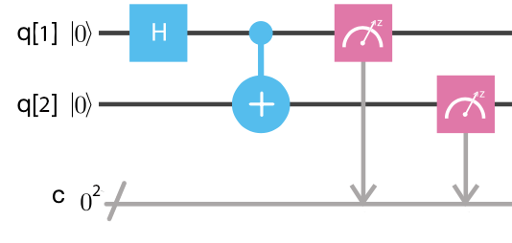
Quantum Circuit
Quantum Circuit is composed of
Quantum and classic registers
Quantum gates
Measurement gates
Example: Bell states
The first Bell state can be created using a Hadamard gate and a CNOT gate.
It creates and entanglement.
Measurement of one qubit will assign one of two possible values to the other qubit instantly.

Slide 35
CONTECTS
Introduction to Quantum Computing
Introduction to Quantum Information
Quantum Hello World!
Introduction to Quantum Algorithms
Quantum Gate Model and Quantum Circuit
Grover’s Algorithm – Overall Procedure
Grover’s Algorithm - Details
Conclusions

Slide 36
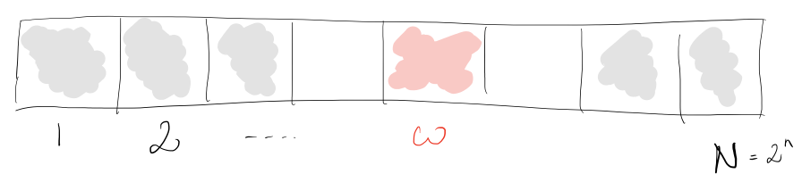
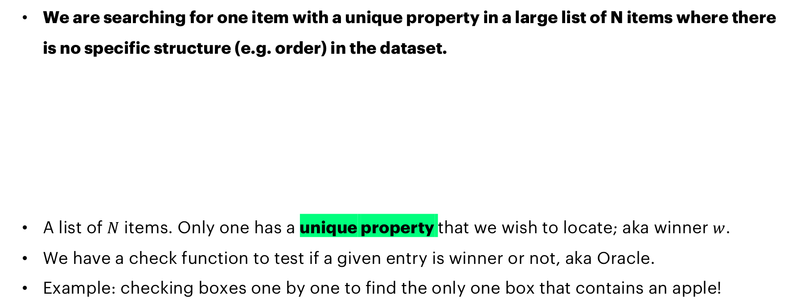
PROBLEM SETUP UNSTRUCTURED DATABASE SEARCH
We are searching for one item with a unique property in a large list of N items where there is no specific structure (e.g. order) in the dataset.
A list of $N$ items. Only one has a unique property that we wish to locate; aka winner $w$.
We have a check function to test if a given entry is winner or not, aka Oracle.
Example: checking boxes one by one to find the only one box that contains an apple!
Notes:
Later on, we will implement a database search algorithm, which is one of the rare algorithms that actually is proven to have quantum speedup
So, there is a list or set of items, one has unique property, and we will call it the winner ( what we want to find from the database)
First, we want to know, how to implement a checking mechanism or function that will tell us if an item was the winner or not
We will call this function ”the oracle” but you can treat it as a checking mechanism or even an if-condition if that help

Slide 37
A Classical Example UNSTRUCTURED DATABASE SEARCH
Find code in GitHub or in myBinder
https://github.com/HassanNaseri/quantum-computing-handson
https://mybinder.org/v2/gh/HassanNaseri/quantum-computing-handson/master
Open the Jupyter Notebook file: search_classic.ipynb
You can run Jupyter Notebook files cell by cell.
The goal is to find the shelf number for a given fruit name
We have access to black_box_check(key, value) function.
black_box_check(key, value)
arguments
key: string
value: 4-bit uint
return
NOT(value) if value=winner
value otherwise

Slide 38
Classical STRUCTURED DATABASE SEARCH Exercise #1
Task 1: Complete the code by giving value to
Maximum_number_of_steps =
Task 2: Complete the code by writing the second for loop
Same loop as before except for using random_indices in the for statement.
How many iterations are needed in average?
black_box_check(key, value)
arguments
key: string
value: 4-bit uint
return
NOT(value) if value=winner
value otherwise

Slide 39
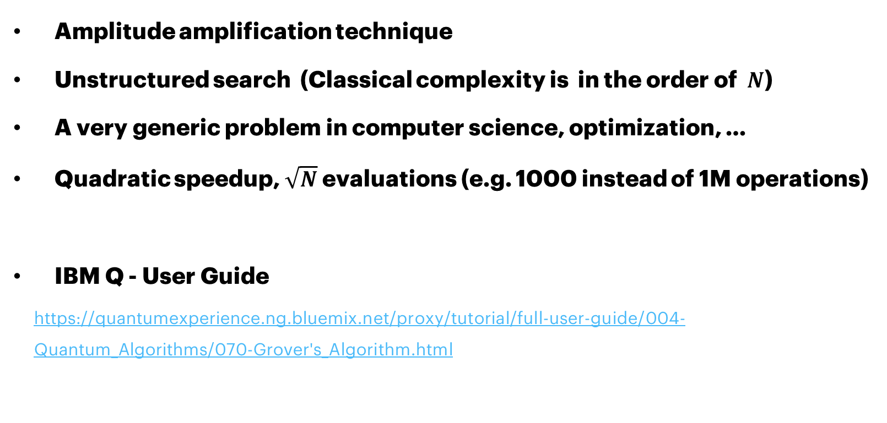
Grover’s Algorithm
Amplitude amplification technique
Unstructured search (Classical complexity is in the order of $N$)
A very generic problem in computer science, optimization, …
Quadratic speedup, $\sqrt{N}$ evaluations (e.g. 1000 instead of 1M operations)
IBM Q - User Guide
https://quantumexperience.ng.bluemix.net/proxy/tutorial/full-user-guide/004-Quantum_Algorithms/070-Grover's_Algorithm.html

Slide 40
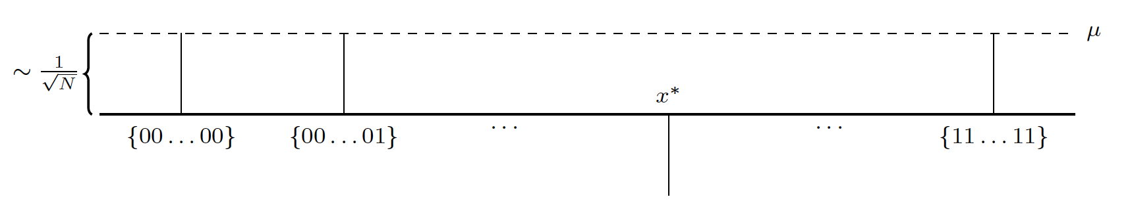
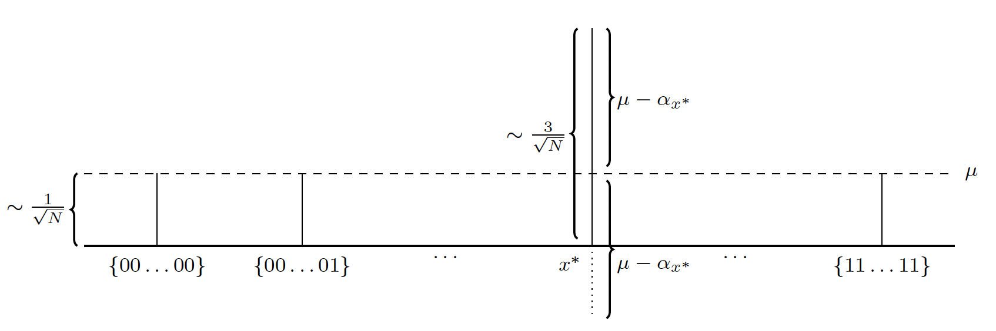
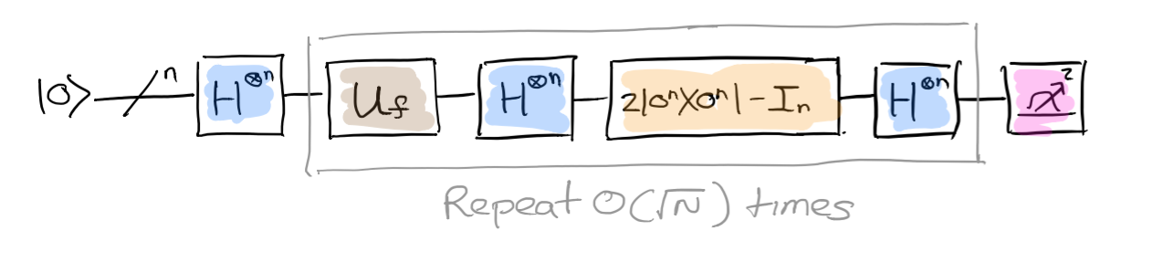
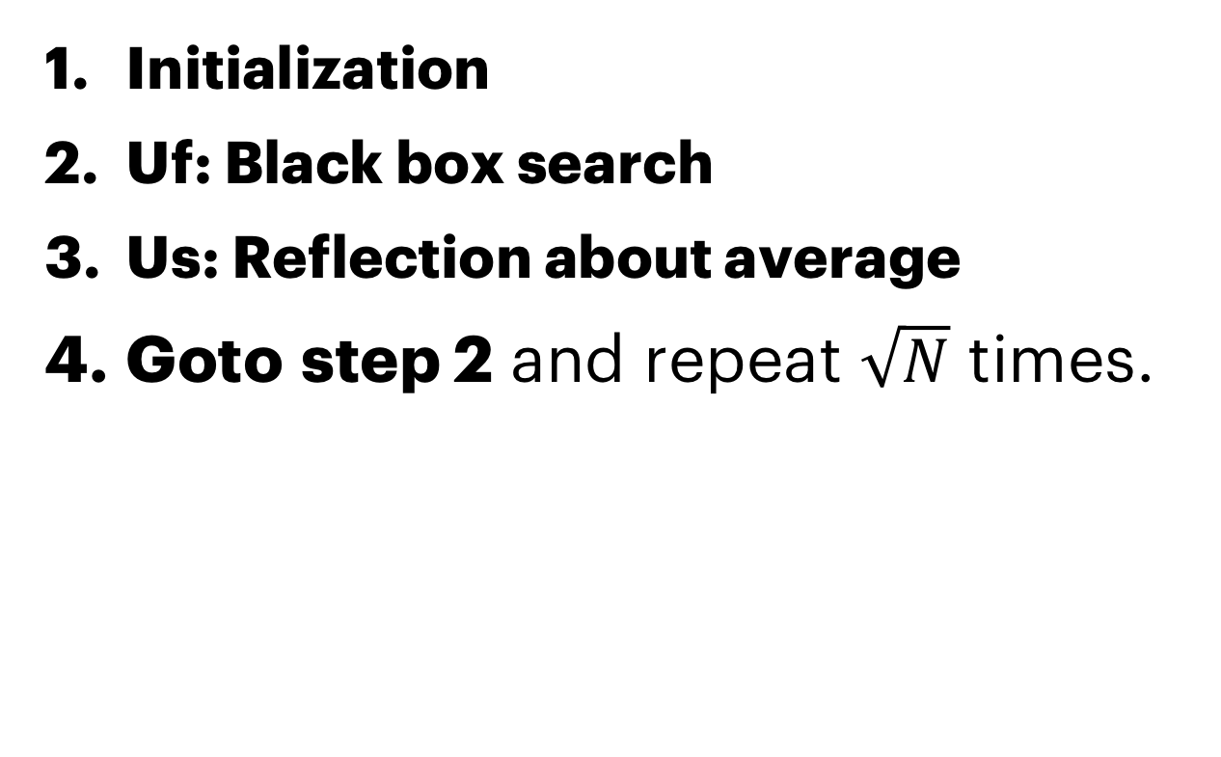
Grover’s Algorithm Overall Process
Initialization
Uf: Black box search
Us: Reflection about average
Goto step 2 and repeat $\sqrt{N}$ times.
Us

Slide 41
Grover’s algorithm Exercise #3
H
U_{f}
U_{s}
Navigate to
https://mybinder.org/v2/gh/HassanNaseri/quantum-computing-handson/master
Open file: grover_1.ipynb
Complete the code by calling two functions:
black_box_check(circuit, key, q)
circuit: quantum circuit object
key: string containing the unique property of interest (fruit name)
q: quantum register for input/output
reflection_about_average(circuit, q)
circuit: quantum circuit object
q: quantum register register for input/output

Slide 42
CONTECTS
Introduction to Quantum Computing
Introduction to Quantum Information
Quantum Hello World!
Introduction to Quantum Algorithms
Quantum Gate Model and Quantum Circuit
Grover’s Algorithm – Overall Procedure
Grover’s Algorithm - Details
Conclusions

Slide 43
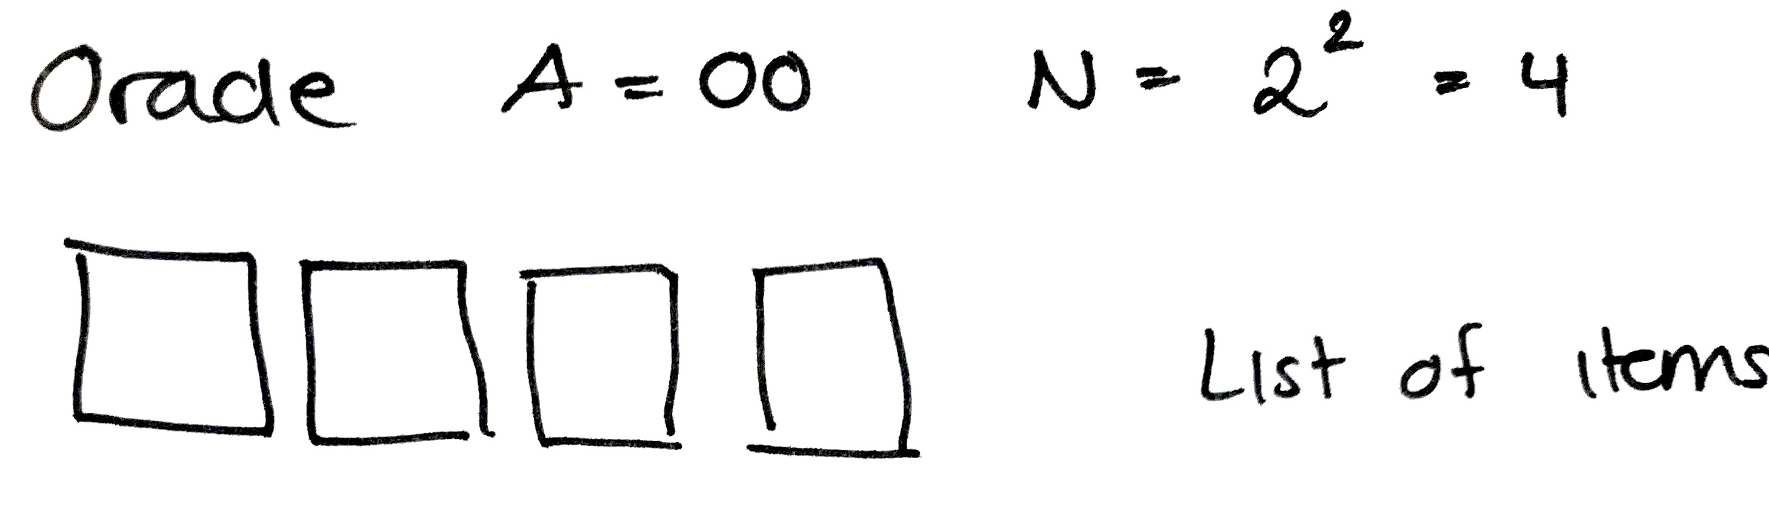
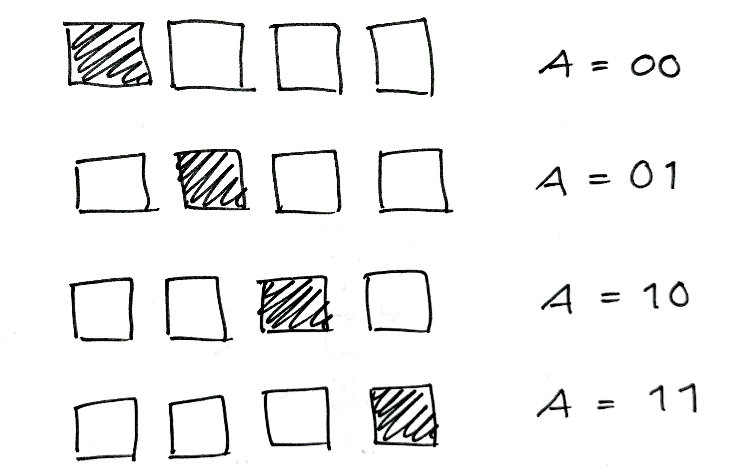
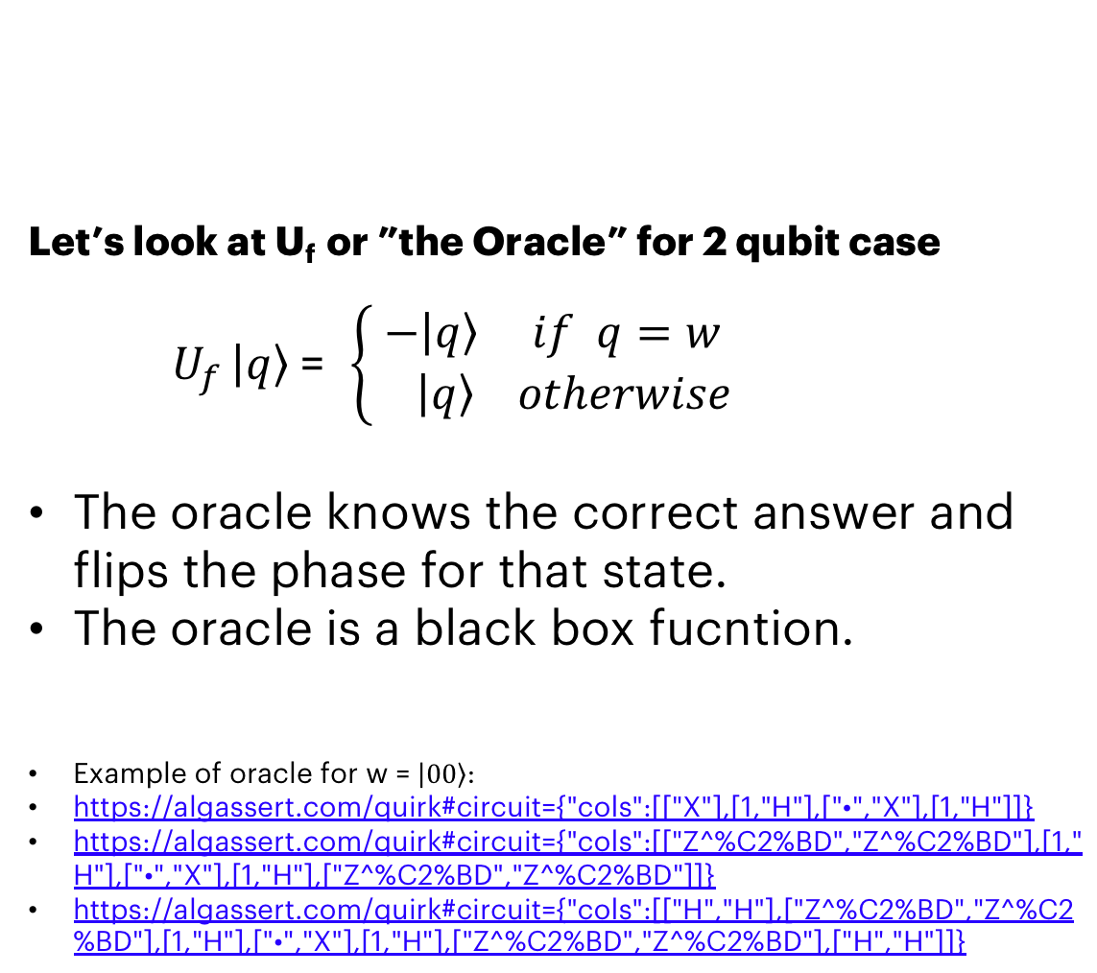
QISKIT Example: The Oracle How to encode a list of items in a quantum computer?
Let’s look at U_{f} or ”the Oracle” for 2 qubit case
$U_{f }\left|\left.q\right\rangle \right.$= $\left\{\begin{aligned}−\left|\left.q\right\rangle if q=w\right. \\ \left|\left.q\right\rangle otherwise\right.\end{aligned}\right.$
The oracle knows the correct answer and flips the phase for that state.
The oracle is a black box fucntion.
Example of oracle for w = $\left|\left.00\right\rangle \right.$:
https://algassert.com/quirk#circuit={"cols":[["X"],[1,"H"],["•","X"],[1,"H"]]}
https://algassert.com/quirk#circuit={"cols":[["Z^%C2%BD","Z^%C2%BD"],[1,"H"],["•","X"],[1,"H"],["Z^%C2%BD","Z^%C2%BD"]]}
https://algassert.com/quirk#circuit={"cols":[["H","H"],["Z^%C2%BD","Z^%C2%BD"],[1,"H"],["•","X"],[1,"H"],["Z^%C2%BD","Z^%C2%BD"],["H","H"]]}
Four possible Oracles:
Notes:
We will give the inputs to the oracle → it checks if this was the winner → it will swap the phase of the amplitude corresponding to the winner state
If statement of a database
Explain with binary initialization first, then superposition state.
This type of encoding is not the only way to do the check, but this particular way will be useful later

Slide 44
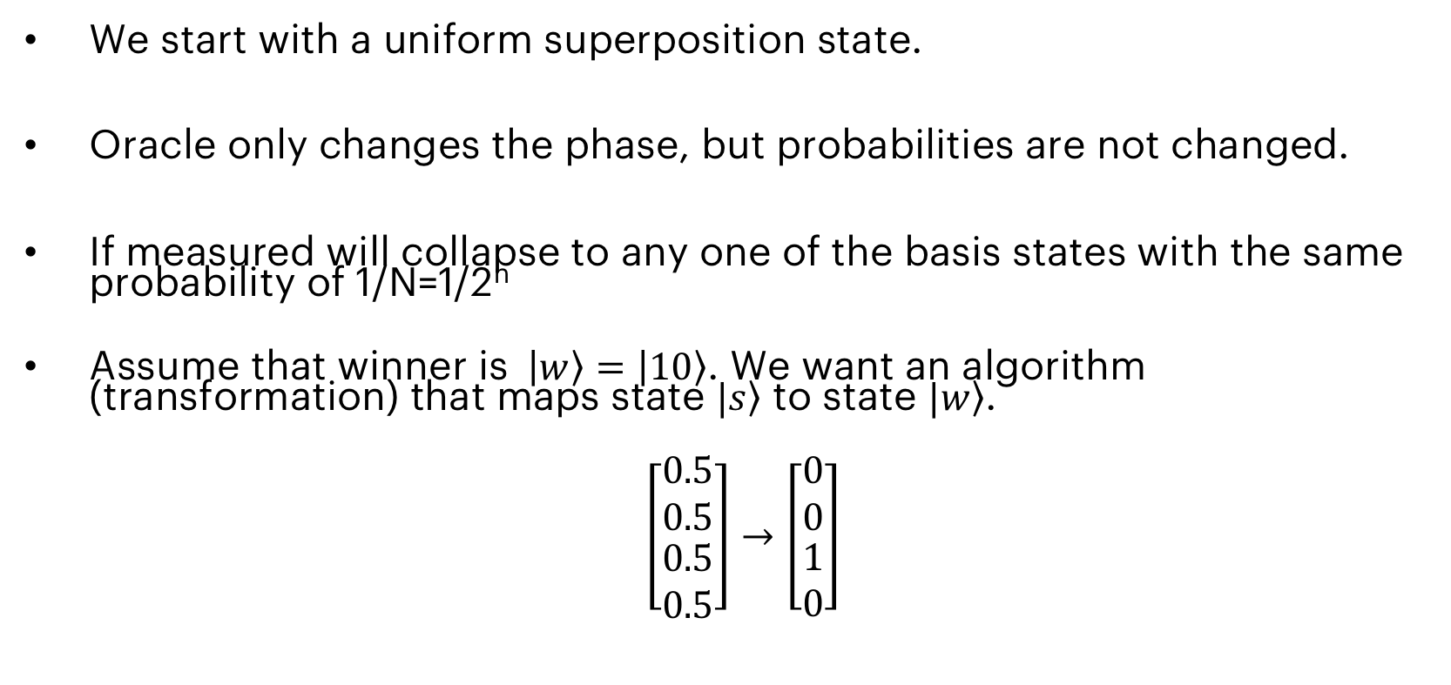
GROVER’S: The LOGIC
We start with a uniform superposition state.
Oracle only changes the phase, but probabilities are not changed.
If measured will collapse to any one of the basis states with the same probability of 1/N=1/2^{n}
Assume that winner is $\left|\left.w\right\rangle \right.=\left|\left.10\right\rangle \right.$. We want an algorithm (transformation) that maps state $|\left.s\right\rangle$ to state $|\left.w\right\rangle$.
$\left[\begin{matrix}0.5 \\ 0.5 \\ \begin{aligned}0.5 \\ 0.5\end{aligned}\end{matrix}\right]→\left[\begin{matrix}0 \\ 0 \\ \begin{aligned}1 \\ 0\end{aligned}\end{matrix}\right]$

Slide 45
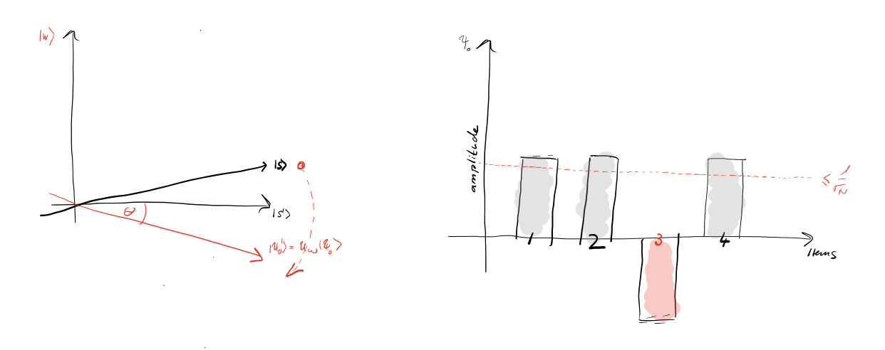
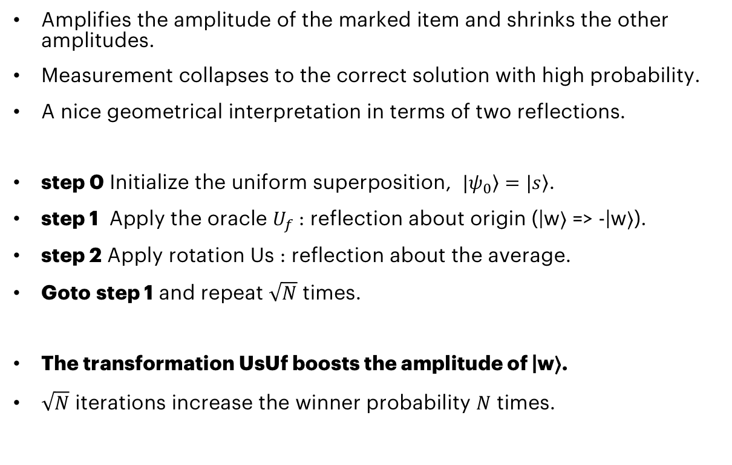
GROVER’s: Amplitude Amplification reflection about the AVERAGE
Amplifies the amplitude of the marked item and shrinks the other amplitudes.
Measurement collapses to the correct solution with high probability.
A nice geometrical interpretation in terms of two reflections.
step 0 Initialize the uniform superposition, $|\left.ψ_{0}\right\rangle =|\left.s\right\rangle$.
step 1 Apply the oracle $U_{f}$: reflection about origin (|w⟩ => -|w⟩).
step 2 Apply rotation Us : reflection about the average.
Goto step 1 and repeat $\sqrt{N}$ times.
The transformation UsUf boosts the amplitude of |w⟩.
$\sqrt{N}$ iterations increase the winner probability $N$ times.

Slide 46
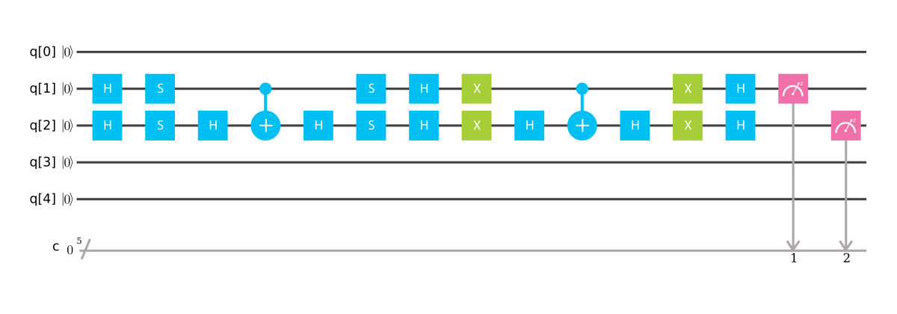
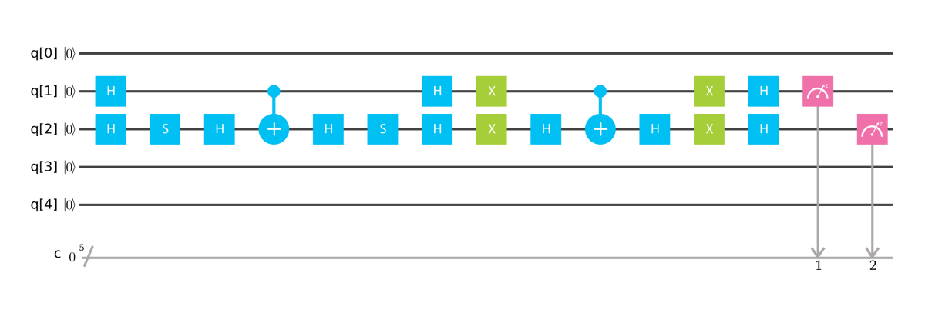
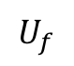
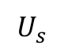
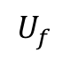

Grover’s: Implementation
$$U_{f}$$
$$U_{s}$$
Implement this using QISKIT or Graphic composer.
Initialize: Hadamard
Uf: using control-Z gate, made from CNOTs
Us: using control-Z gate.
Examples
Grover N=2 A=00
Grover N=2 A=01
Grover’s algorithm: N=2, A=00
$$U_{f}$$
$$U_{s}$$
Grover’s algorithm N=2, A=01

Slide 47
Grover’s algorithm Exercise #4
Navigate to
https://mybinder.org/v2/gh/HassanNaseri/quantum-computing-handson/master
Open file: grover_2.ipynb
Complete the code by implementing the function:
reflection_about_average(circuit, q)
circuit: quantum circuit object
q: quantum register register for input/output
Gates needed:
H : Hadamard
X : Pauli X-gate
CX: CNOT GATE
How to implement CNOT
circuit.cx(q[0], q[1])

Slide 48
Solution
def reflection_about_average(circuit, q):
# Reflection about average for amplitude amplification
circuit.h(q)
circuit.x(q)
circuit.h(q[1])
circuit.cx(q[0], q[1])
circuit.h(q[1])
circuit.x(q)
circuit.h(q)

Slide 49


Grover’s: THE QUANTUM TRICK!
We did not check for each shelf separately.
We did not ask if apple is in shelf number 1.
We asked if the apple in shelfs: 1 + 2 + 3 + 4 with 25% probability each!
The exact input is:
$\frac{1}{2}\left|\left.00\right\rangle +\frac{1}{2}\right|\left.01\right\rangle +\frac{1}{2}|\left.10\right\rangle +\frac{1}{2}|\left.11\right\rangle$
The output is:
$$0\left|\left.00\right\rangle +0\right|\left.01\right\rangle +1|\left.10\right\rangle +0|\left.11\right\rangle$$
The measurement almost always collapses to the correct state: $|\left.10\right\rangle$.
$\left[\begin{matrix}0.5 \\ 0.5 \\ \begin{aligned}0.5 \\ 0.5\end{aligned}\end{matrix}\right]→\left[\begin{matrix}0 \\ 0 \\ \begin{aligned}1 \\ 0\end{aligned}\end{matrix}\right]$

Slide 50
CONTECTS
Introduction to Quantum Computing
Introduction to Quantum Information
Quantum Hello World!
Introduction to Quantum Algorithms
Quantum Gate Model and Quantum Circuit
Grover’s Algorithm - Overall Procedure
Grover’s Algorithm - Details
Conclusions

Slide 51





Conclusions: hardware AND SOFTWARE
There is no standard architecture or de facto technology yet.
Current computer are very limited:
They are very few and fragile.
The have limited capacity.
The coherence time is short.
The technology is not fault-tolerant.
The progress has just started and it is believed to grow very fast!
Plenty of things can/should be done before the ultimate hardware is ready.
Software development tools:
IBM Q Experience
Qiskit SDK
Qiskit Aqua and other repositories: Aqua Chemistry, Aqua Optimization, Aqua Artificial Intelligence
D-Wave: Internet API and programming libraries (C/C++, Python, and MATLAB)
Microsoft: Quantum SDK, Q# (a new piece for Visual Studio) Azure simulator
Google: Cirq (A python framework similar to Qiskit)

Slide 52

Quantum Computing at Accenture
Quantum Computing Roadmap (next generation of computing)
End-users, Application Developer, Service Provides, Technology Developers
Quantum research teams in more than 20 countries
Partnership with 1QBit and development on D-Wave machines
Accenture-IBM Quantum Hub Project
A global collaboration project among Accenture teams and IBM
Develop business-driven prototypes on IBM quantum computers
Access to latest IBM quantum computers and resources

Slide 53
SOME Resources
A good introductory tutorial on quantum computing: https://people.cs.umass.edu/~strubell/doc/quantum_tutorial.pdf
A video series on quantum computing (YouTube): https://www.youtube.com/watch?v=X2q1PuI2RFI&list=PL1826E60FD05B44E4
IBM Q Experience user guide: https://quantumexperience.ng.bluemix.net/proxy/tutorial/full-user-guide/introduction.html
A nice tool for learning (QUIRK): https://algassert.com/quirk
A white paper from Accenture Labs (Innovating with Quantum Computing): https://www.accenture.com/t00010101T000000__w__/br-pt/_acnmedia/PDF-45/Accenture-Innovating-Quantum-Computing-Novo.pdf
Quantum Developer Week, Accenture Media Exchange: https://mediaexchange.accenture.com/media/t/0_s769log0
Quantum Computing Lecture including Linear Algebra (The University of Chicago) http://people.cs.uchicago.edu/~razborov/teaching/QuantumComputing/notes.pdf
Grover’s algorithm: https://www.cs.cmu.edu/~odonnell/quantum15/lecture04.pdf
For a curious mind: Richard Feynman’s lecture on quantum mechanics: https://www.youtube.com/watch?v=OYp_Mq_-Q0s

Slide 54
Thank You! QUESTIONS?
Hassan Naseri
Tim Leonhardt

